Slide 1


Connecting Presidential Collections
CPC aggregates metadata from digital collections by or about the U.S. presidents.
Sheila Blackford
Librarian
Amber Reichert
Web Developer

Slide 2
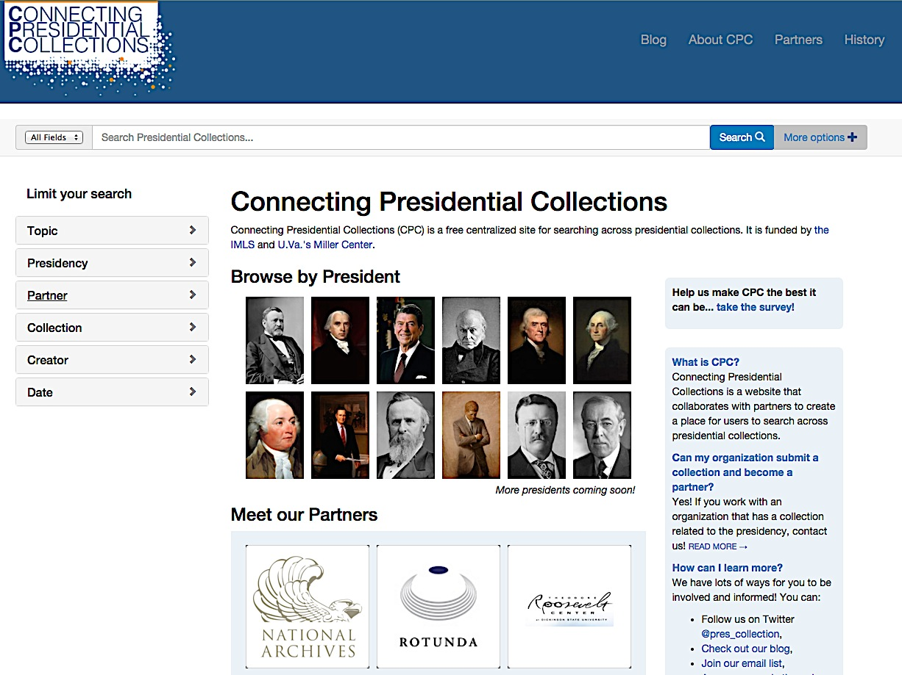

Slide 3


Funded by

Slide 4
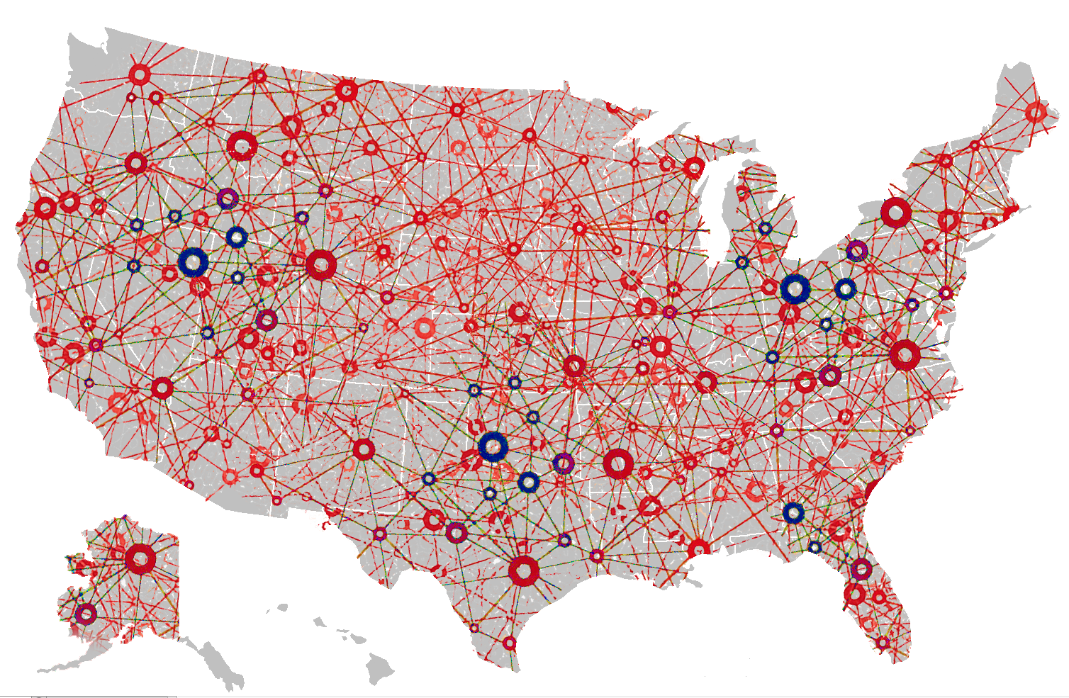
Map?

Slide 5
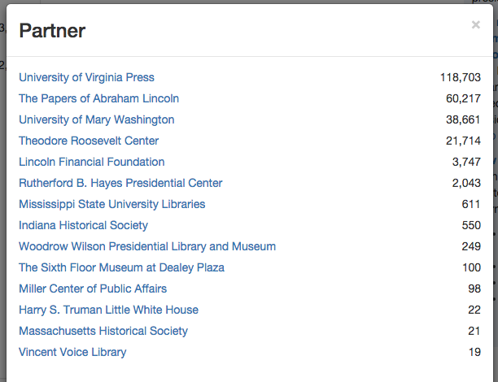

Slide 6
“You want people to digitize… but to what end? What’s in it for me?”
“We desperately need help with digitizing”
“Scanning is the least of it—you can’t just scan and that’s it, you have to have time to describe.”
“Our IT department doesn’t have the time to fix us”
“We need people willing to work for low wages”

Slide 7
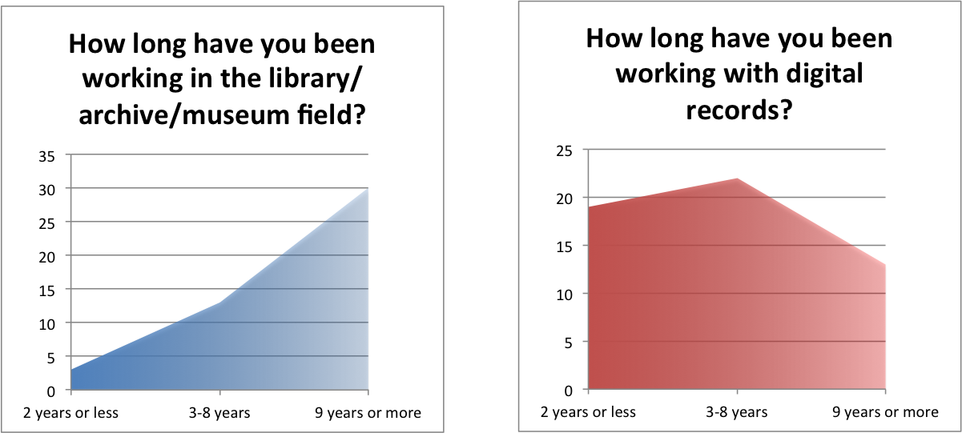

Slide 8
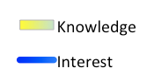
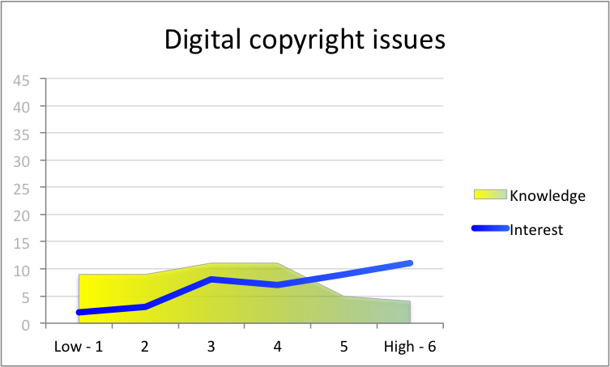
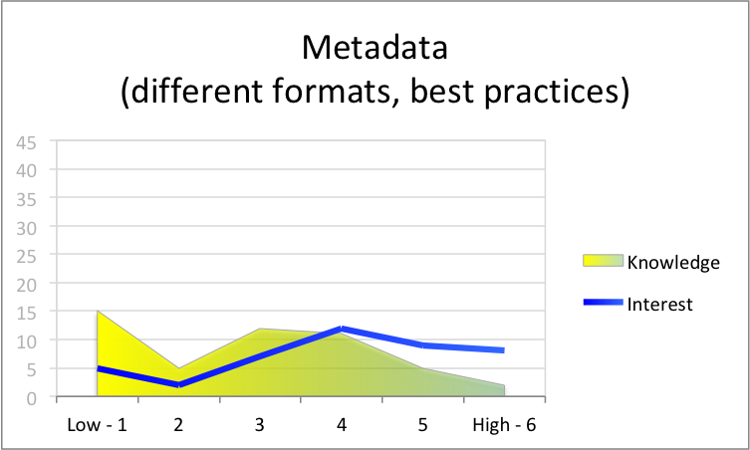
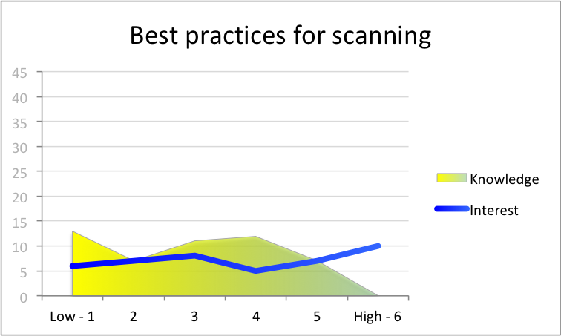
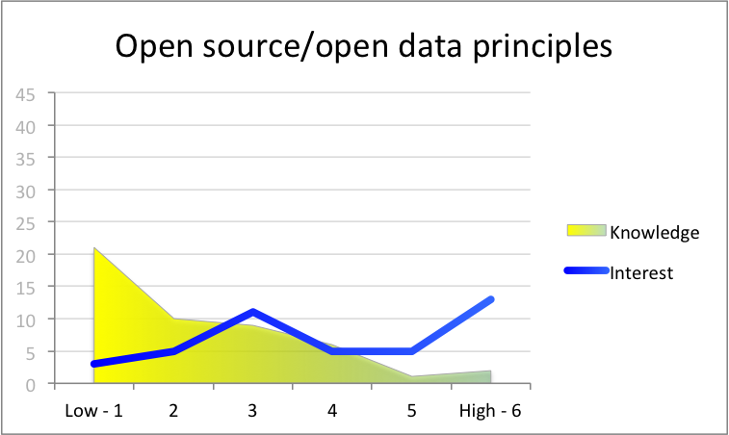
“Please rate your level of [knowledge of]/ [interest in learning about] the following areas…
Digital Copyright Issues
Metadata
(different formats, best practices)
Best Practices
for Scanning
Open Source/Open Data
Principles

Slide 9
Key Specific Needs
$$$ (/people)
Access to technology (ex: better software)
Tech training (ex: how do I edit metadata records in our system?)

Slide 10
What does this mean for CPC?
slow + steady
building critical mass
We’re in it for the long haul!

Slide 11
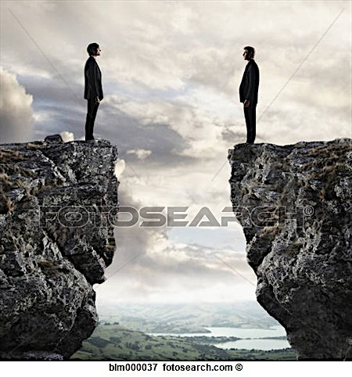
What does this mean for our field?
“You want people to digitize… but to what end? What’s in it for me?”
How do we protect the things that really matter?

Slide 12
“You want people to digitize… but to what end? What’s in it for me?”
How do we protect the things that really matter?

Slide 13
